Slide 1
Smart I (eye) Advisory Rescue Systems (SIARS)
NATO - Science for Peace Project EAP.SFPP 984753

Slide 2
PROJECT PARTNERS
LJ1 - UoL-FE – University of Ljubljana, Faculty of Electrical Engineering, SLOVENIA;
LJ2 -UoL-MF- University of Ljubljana, Faculty of Medicine, SLOVENIA;
SK1 - UGD – MA – Goce Delchev University, Military Academy “General Mihailo Apostolski” – Skopje; the former Yugoslav Republic of Macedonia*
SK2 - UKIM – FCSE –University St.Cyril and Methodious, Faculty of Computer Science and Engineering, the former Yugoslav Republic of Macedonia
PROJECT DURATION
08.04.2015 – 08.04.2018 – 3 (three) years.
*Turkey recognises the Republic of Macedonia with its constitutional name.

Slide 3
INTRODUCTION
Development of Telemedical Information System will covered this “Next” level of medical procedure by using:
  mobile device, radio conection, biosensors and other sophisticated equipment;
  measure all vital parameters; and
  send it to the Mobile base stations placed in medical vehicles which will communicate to the next levels of medical support units (Role 1, Role 2 or Role 3 medical units)

Slide 4
Objectives of the project Siars
Comparative analysis with the other telemedical information systems (IS) used in military environment
Development of a modular platform that can be latter upgraded with additional medical services
Selection and description of security standards for SOA – to be used for achieving certain control level for access and authentification
Definition of a IS model with modules that can provide efficient information exchange
Development of prototype services (applications) for distributed telemedical IS that can work locally or via satellite connection
FUNDING PROVISIONS AND CONDITIONS.
You can affect change.
Notes:
Bringing it to the classroom– making these tools relevant to students daily lives– to make a difference
Make noise. Get noticed. Get the message out.

Slide 5
Smart I (Eye) Advisory Rescue System based on SOA
Model of SIARS

Slide 6
Advisory module / OFFLINE Module
The Advisory module – learning/advisory for FARs continual education
The Offline module for collection of vital parameters of injured individual
  works independently
  Providing automatic TRIAGE
  analyze the digital record of vital parameters; and
  record it in order to process it to the higher level of military medical institutions

Slide 7
BENEFITS OF SIARS
Effective transformation of management in medicine which will be implemented using the Telemedical System;
SIARS will reduce the time of manually collection of vital parameters of injured individual;
Automatic TRIAGE process
processing of information to the higher levels of medical care;

Slide 8
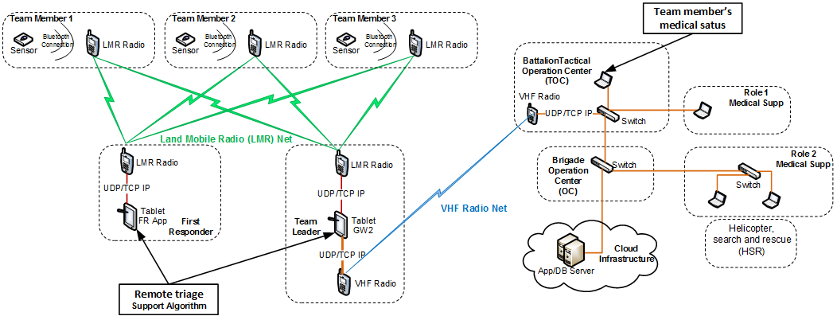
System architecture
The new slide

Slide 9
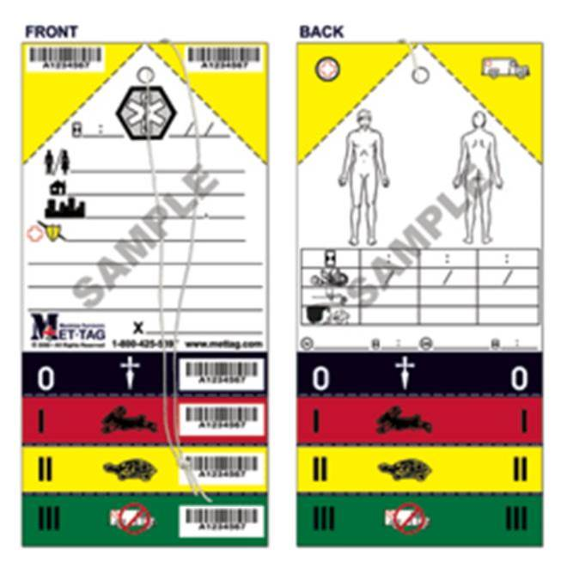
TRIAGE cards
Red tags/cards - (immediate)
are used to label those who cannot survive without immediate treatment but who have a chance of survival.
Yellow tags/cards - (observation)
  or those who require observation (and possible later re-triage). Their condition is stable for the moment and, they are not in immediate danger of death. These victims will still need hospital care and would be treated immediately under normal circumstances.
Green tags/cards - (wait)
  are reserved for the "walking wounded" who will need medical care at some point, after more critical injuries have been treated.
White tags/cards - (dismiss)
  are given to those with minor injuries for whom a doctor's care is not required.
Black tags/cards - (expectant)
  are used for the deceased and for those whose injuries are so extensive that they will not be able to survive given the care that is available
NATO CARD (METTAG)(FRONT) NATO CARD (METTAG)(BACK)

Slide 10
Functionality of the Telemedical System
  precise and fast determining the patient`s vital parameters,
  proceed it to the next level of military medical units together with additional data (ID, Time, Location, Coordinates);
  it can be implemented in every unit that performs military operations;
SIARS will be fitted into the existing process of work and will improve the existing process of work.
Functionality of the system to be checked on some military or medical exercise;

Slide 11
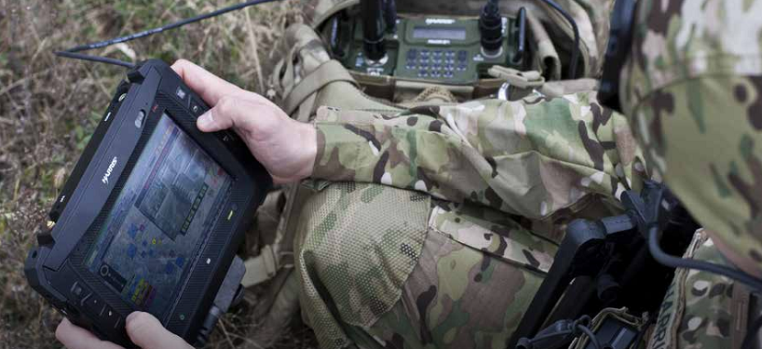
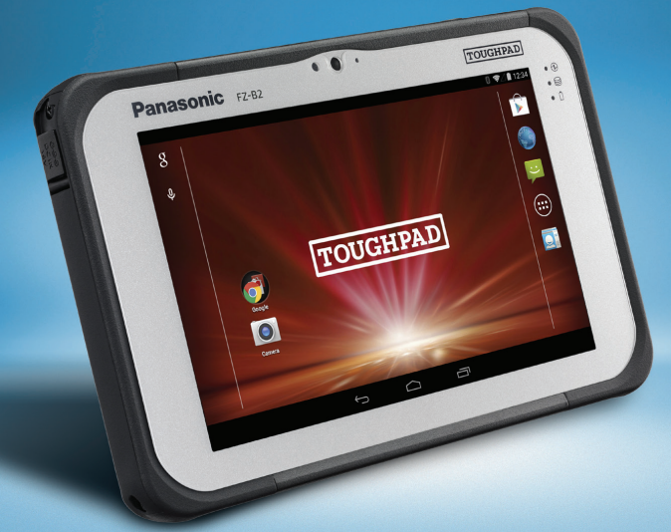
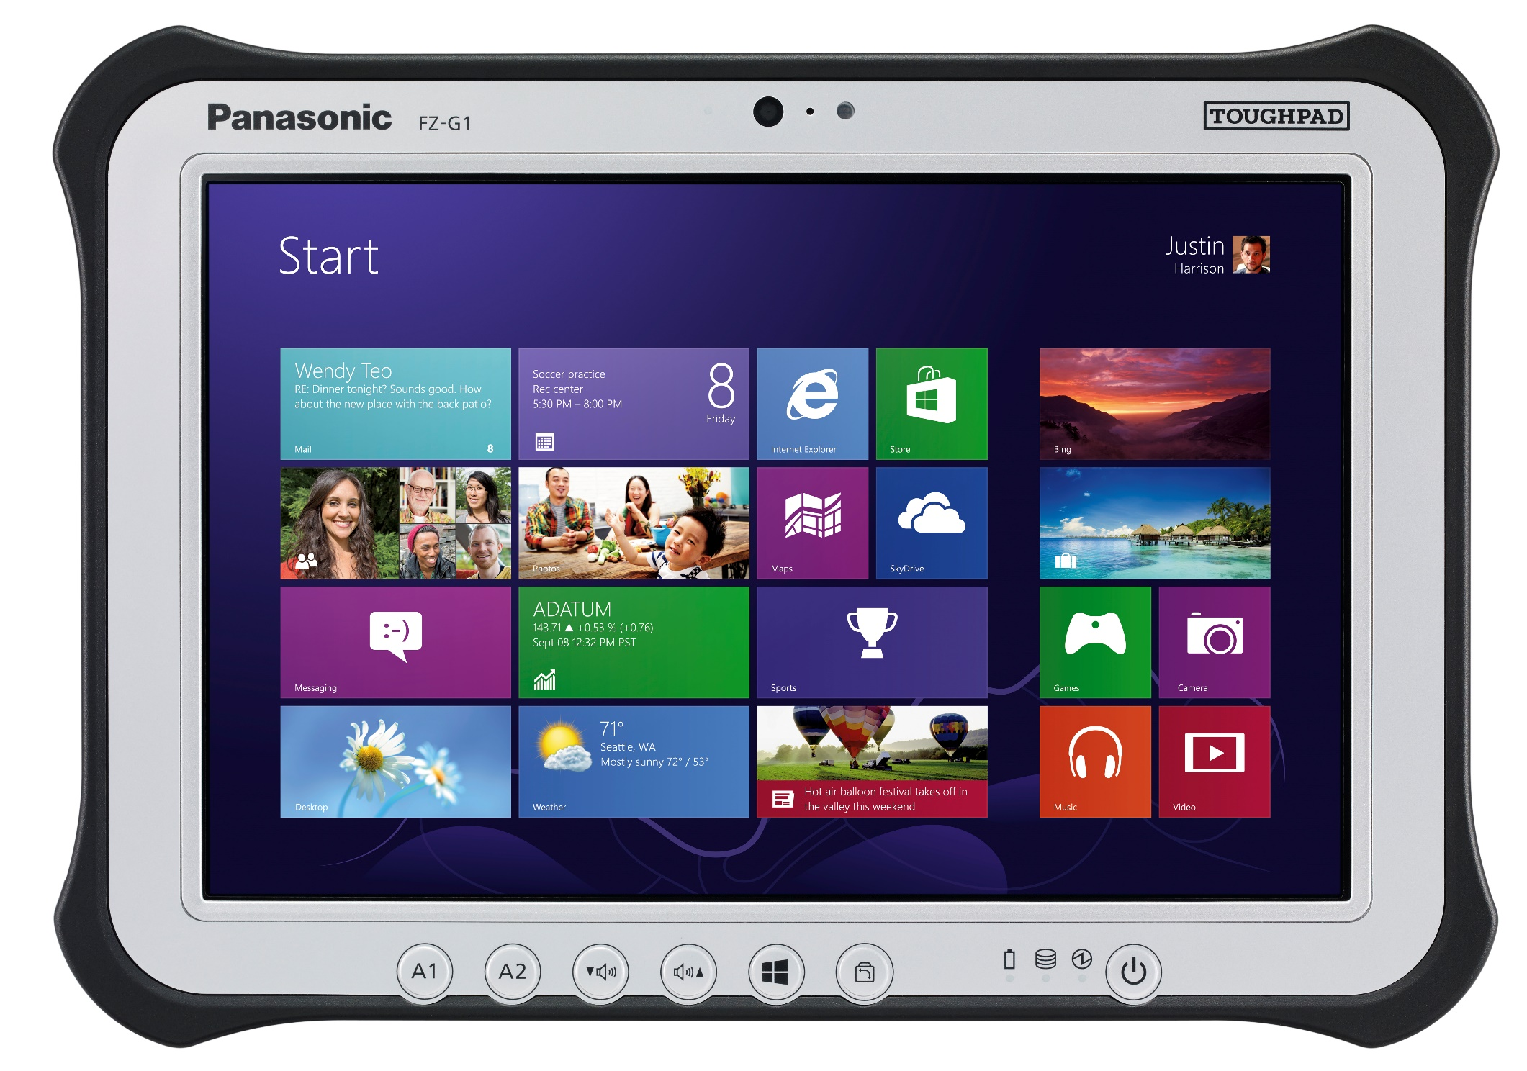
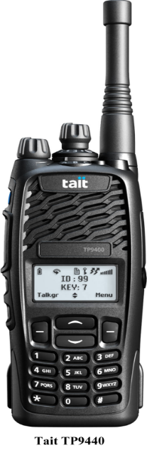
MILITARY STANDARDS - HW and SW
Harris RF-3590 Ruggedized Tablet
Panasonic Toughpad FZ-B2
(OS: ANDROID)
$4000
< $2000
Panasonic Toughpad FZ-M1 (OS: Windows)
< $2000

Slide 12
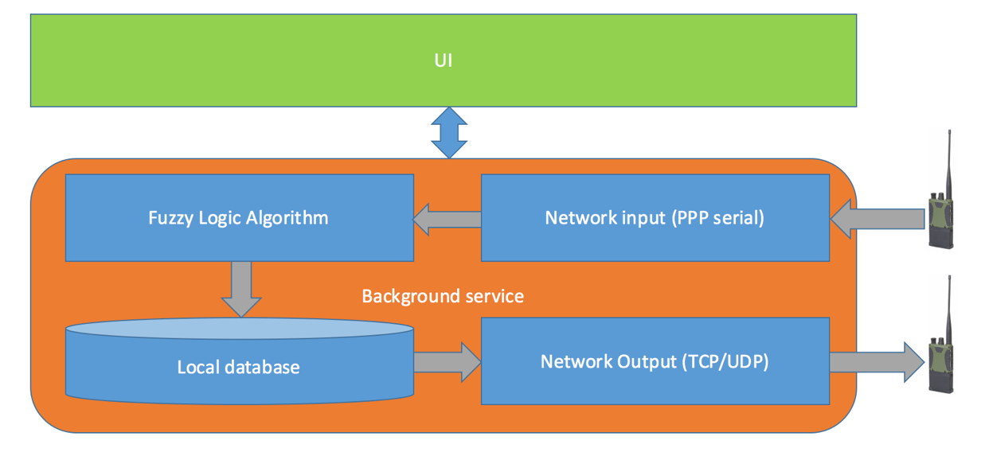
MAIN contributions of SIARS
  Algorithm for distance TRIAGE

Slide 13
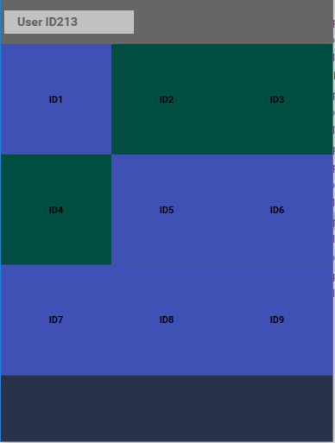
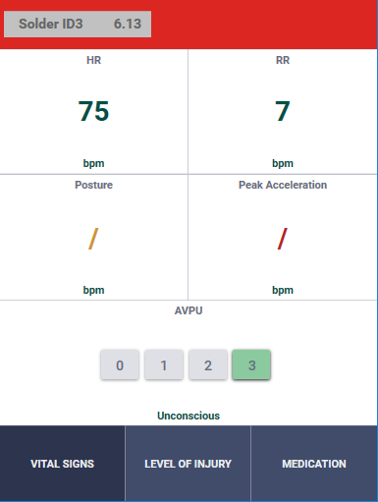
Interface of the Triage algorithm – FAR tablet

Slide 14

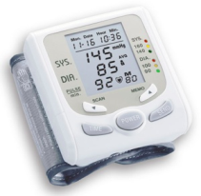
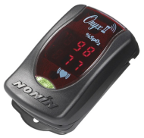
The used Biosensors

Slide 15
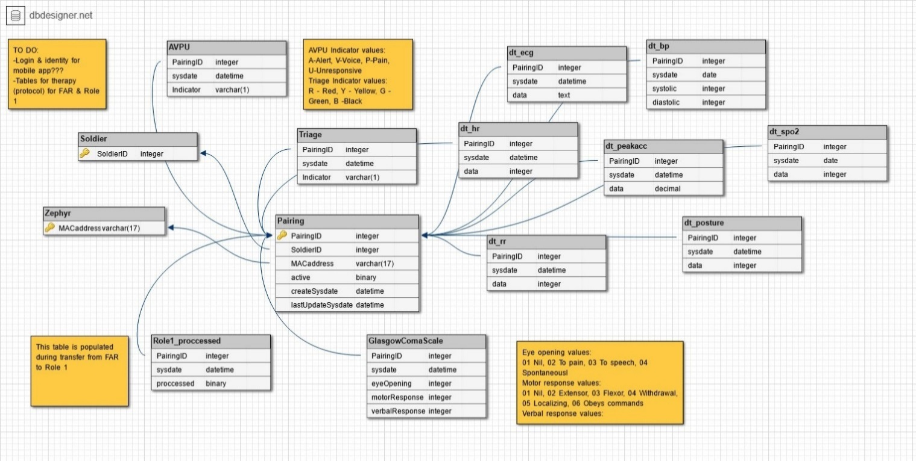
Server side software

Slide 16
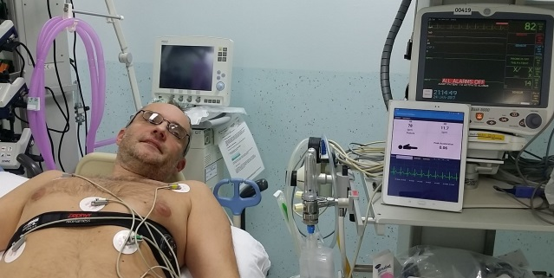
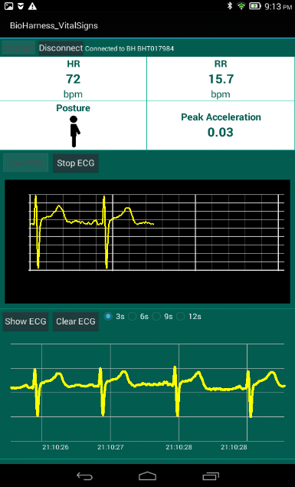
  Application for Celje hospital – reading ECG
Mobile application for General Hospital in Celje
This application confirms the usefulness of the Zephyr Bioharness sensor in a hospital environment by providing remote monitoring of a patient vital parameters. The application is set and tested in General Hospital in Celje, Slovenia.

Slide 17
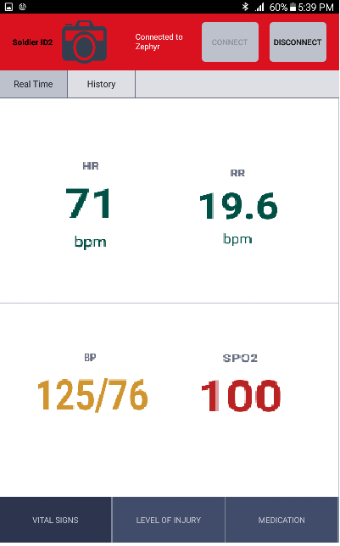
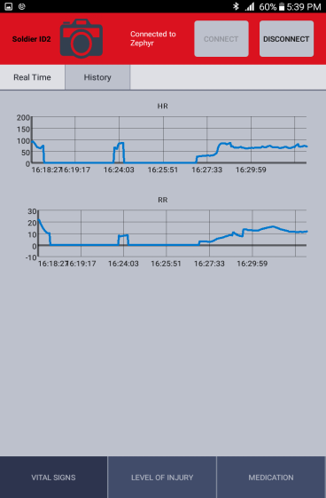
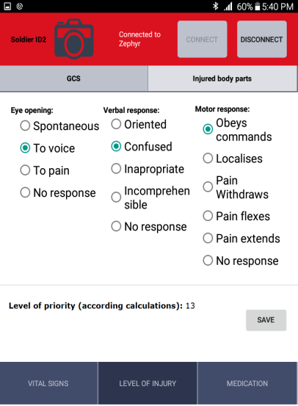
Mobile application for the medical need in Role 1 - during transportation of a patient

